Slide 1





Thank you to our Global Sponsors and Supporters

Slide 2

We are thrilled to say the first ever PASS Virtual Summit will be taking place this November!
We will be launching PASS Summit into a whole new world, and with that comes exciting opportunities with what we can offer you. We will go beyond simply moving sessions online to fully embracing everything a virtual environment can offer.
Find out more at PASS.org/summit - Utah County SQL Group discount code - LGDIS6I0T ($50 off registration)

Slide 3
Session Evaluations
https://www.sqlsaturday.com/997/Sessions/Session-Evaluation
Alternatively go to the Schedule and click on the session you would like to give feedback on and click Session Evaluation

Slide 4
Utah Geek Events slack channels for attendees to chat
To get an invite to the Slack Space
http://bit.ly/2bm3vwW
Channels
#sqlsaturday997_room1
#sqlsaturday997_room2
#sqlsaturday997_room3
#sqlsaturday997_room4

Slide 5






Let's take PowerBI on an adventure

Slide 6



TJay Belt
Data Architect at Health Equity
eMail me TJayBelt@yahoo.com
Read me http://tjaybelt.blogspot.com
Follow me @tjaybelt

Slide 7
Introduction
What this session is
Collect and display data from adventures
PowerBI is a part of the process
What’s the goal?
Collect, trend, display and reflect on my data

Slide 8
Introduction
What this session is
Not helpful at all for your job?
Will waste time not talking about PowerBI stuff
What’s the goal?
Collect, trend, display and reflect on my data

Slide 9
Introduction
What this session is NOT
Only about PowerBI
Cool tricks and tips and processes for PowerBI
Remember the goal?
Collect, trend, display and reflect on my data

Slide 10
My Data
This is my data, I may be the only consumer
Quick and dirty way to look at trends and totals
Find patterns
Determine what brings me joy
See where I can improve
Relive adventures
Notes:
As a age, I realize that exercise is important.
And these forms of exercise are things that make me happy.
I realize that hiking simple hikes is harder on my knees.
Periodically I feel like I must do a hard hike. How is that trend going to affect the rest of my exercise.
Recently, upon review of my ped al bike I noticed a trend.
On rides where I was climbing 800 to 1200 ft, I was getting exercise but I was getting really slow.
So if the goal was to exercise, then knowing that large climbs are going to be painful for me.
But since I was riding with a group I also noticed that I was going slower than the rest of them.
If I compared my rides ride over a similar path I noticed that I wasn't getting any faster and that I was spending a lot of time waiting

Slide 11
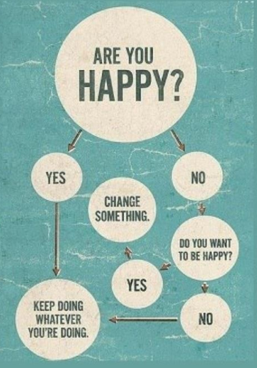

My Data
Why collect this data?
To find my happy
To use my time wisely

Slide 12

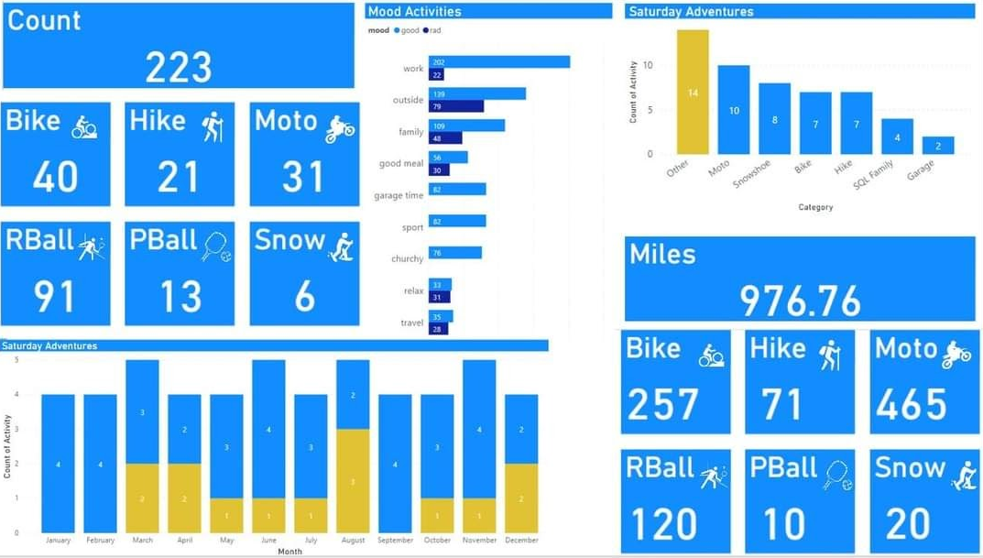
My Data
End result? A year end review of my adventures

Slide 13

Where is my data?
Garmin device
Daylio app
Google Maps
Google Calendar
Google Photos
Facebook / Instagram Photos

Slide 14
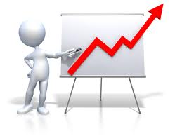
Where is my data?
Let’s go get some adventure data

Slide 15
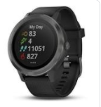
Garmin Device
Wearable device
Take it on each adventure
Start and stop with each adventure
Sync with cloud
Review and modify data

Slide 16
Garmin Device – Review and Modify Data
Give each activity a proper name
YYYY-MM-DD Type – Name
2020-08-25 Bike – Valley Vista
Extract data to a .gpx file
Add data to Base Camp app

Slide 17

Garmin BaseCamp App
Windows app
Use on my home desktop to …
Collect activities
Organize activities
Review activities
Combine and extract activities

Slide 18
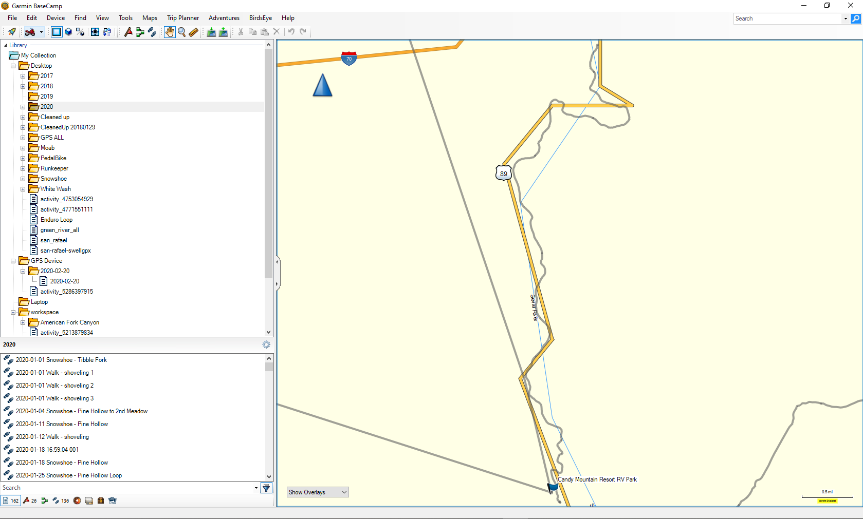
Garmin BaseCamp App

Slide 19
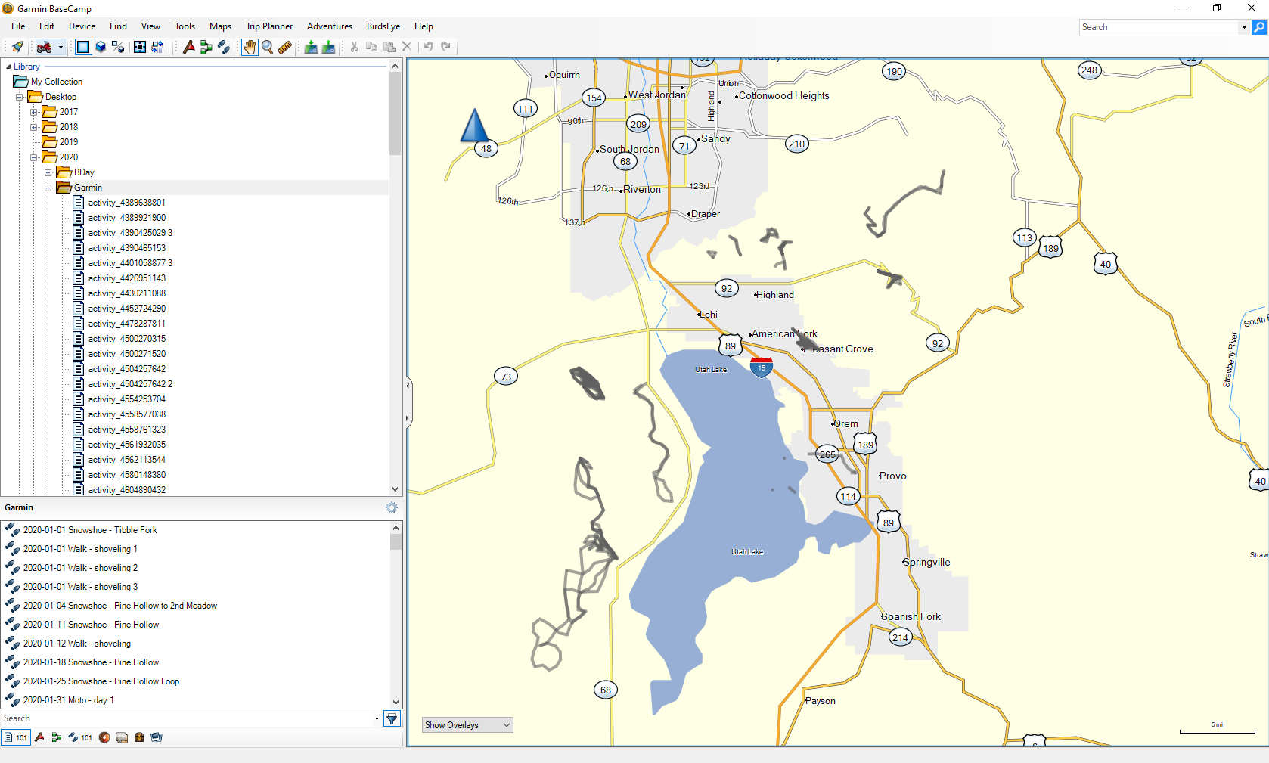
Garmin BaseCamp App

Slide 20
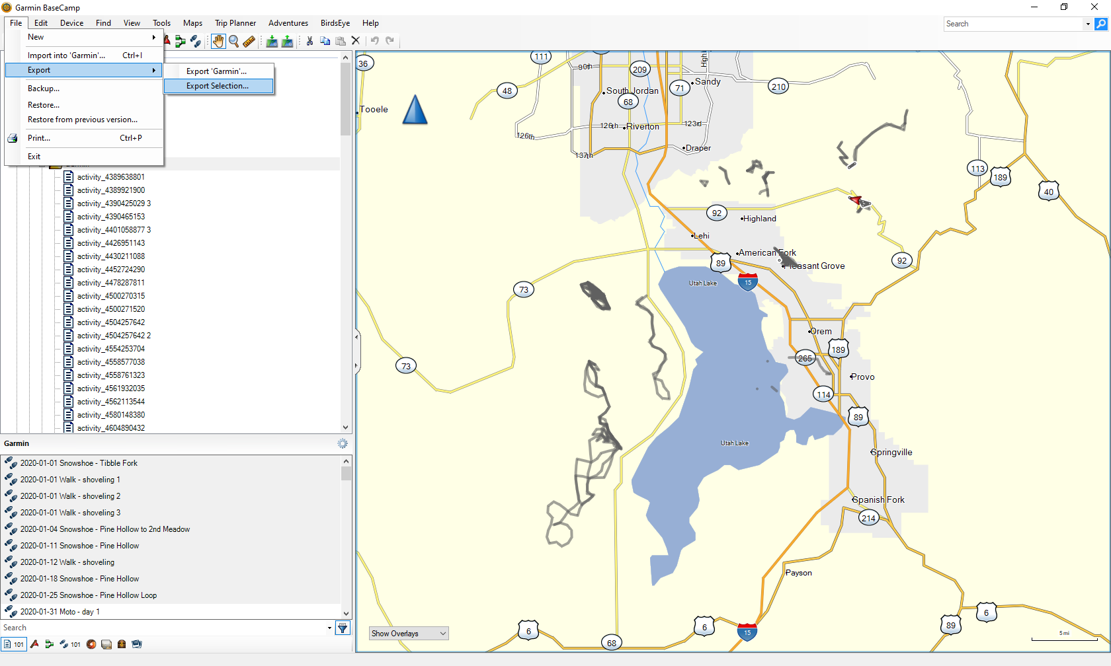
Garmin BaseCamp App

Slide 21
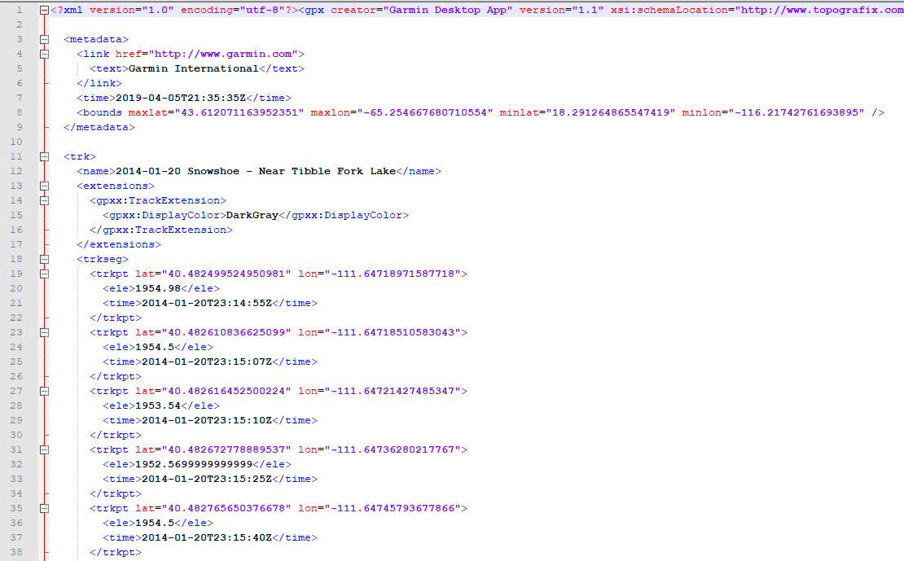
Garmin BaseCamp App

Slide 22
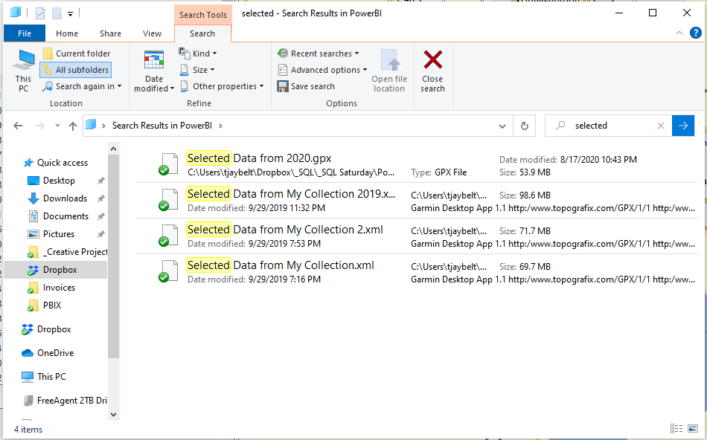
Garmin BaseCamp App

Slide 23
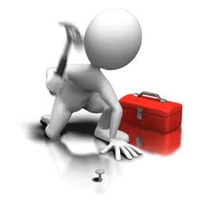
Make the Data count
Let’s add data

Slide 24
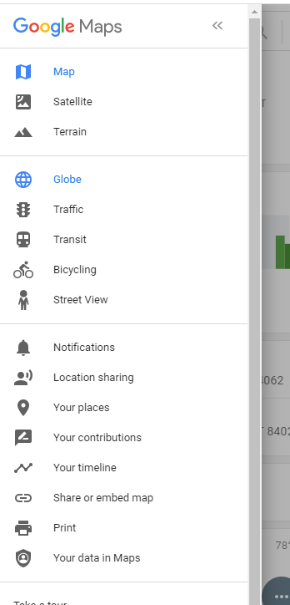
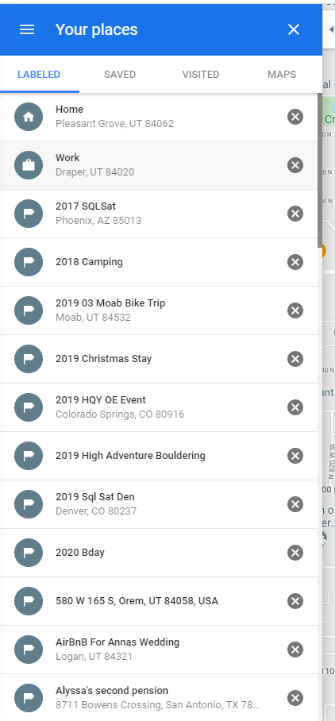
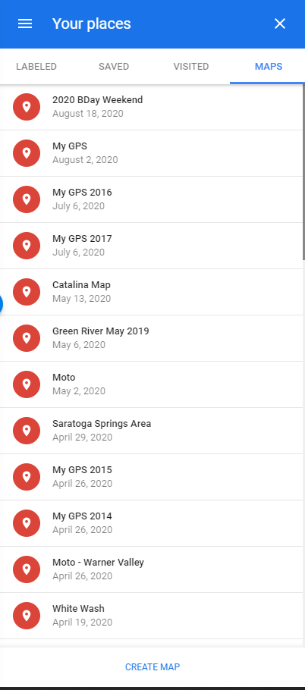
Google Maps

Slide 25
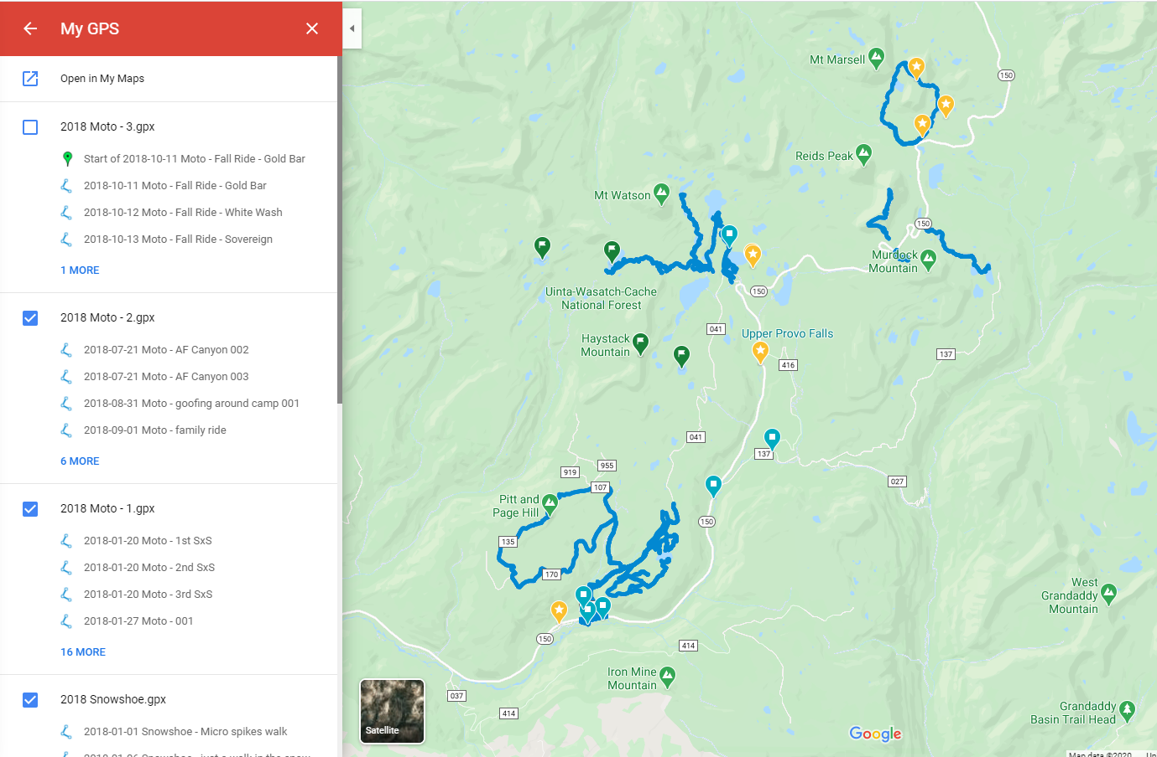
Google Maps

Slide 26
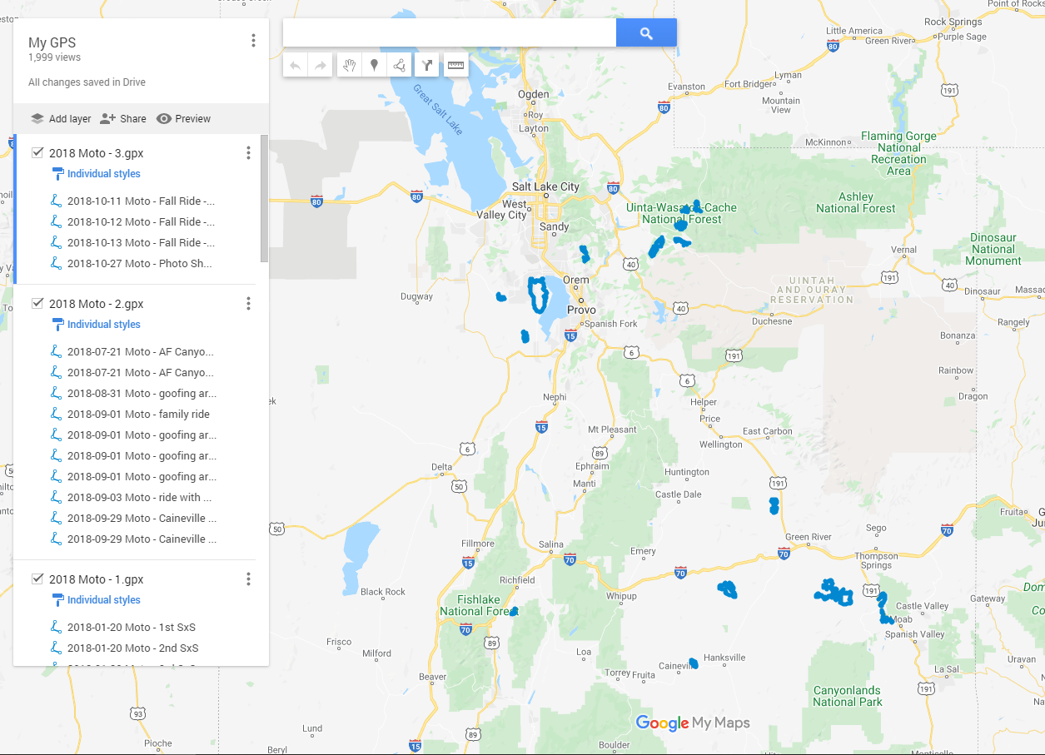
Google Maps

Slide 27

Google Maps
Let’s take an actual look at Google Maps

Slide 28
Google maps - Timeline

Slide 29
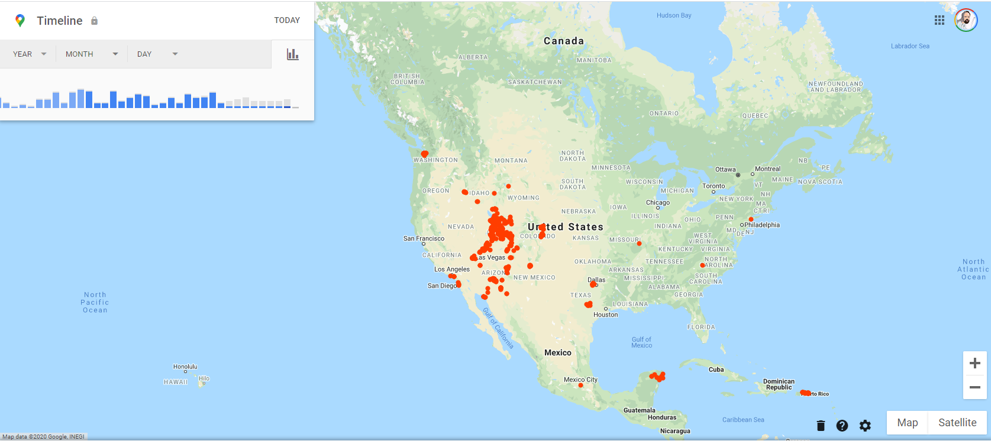
Google maps - Timeline

Slide 30
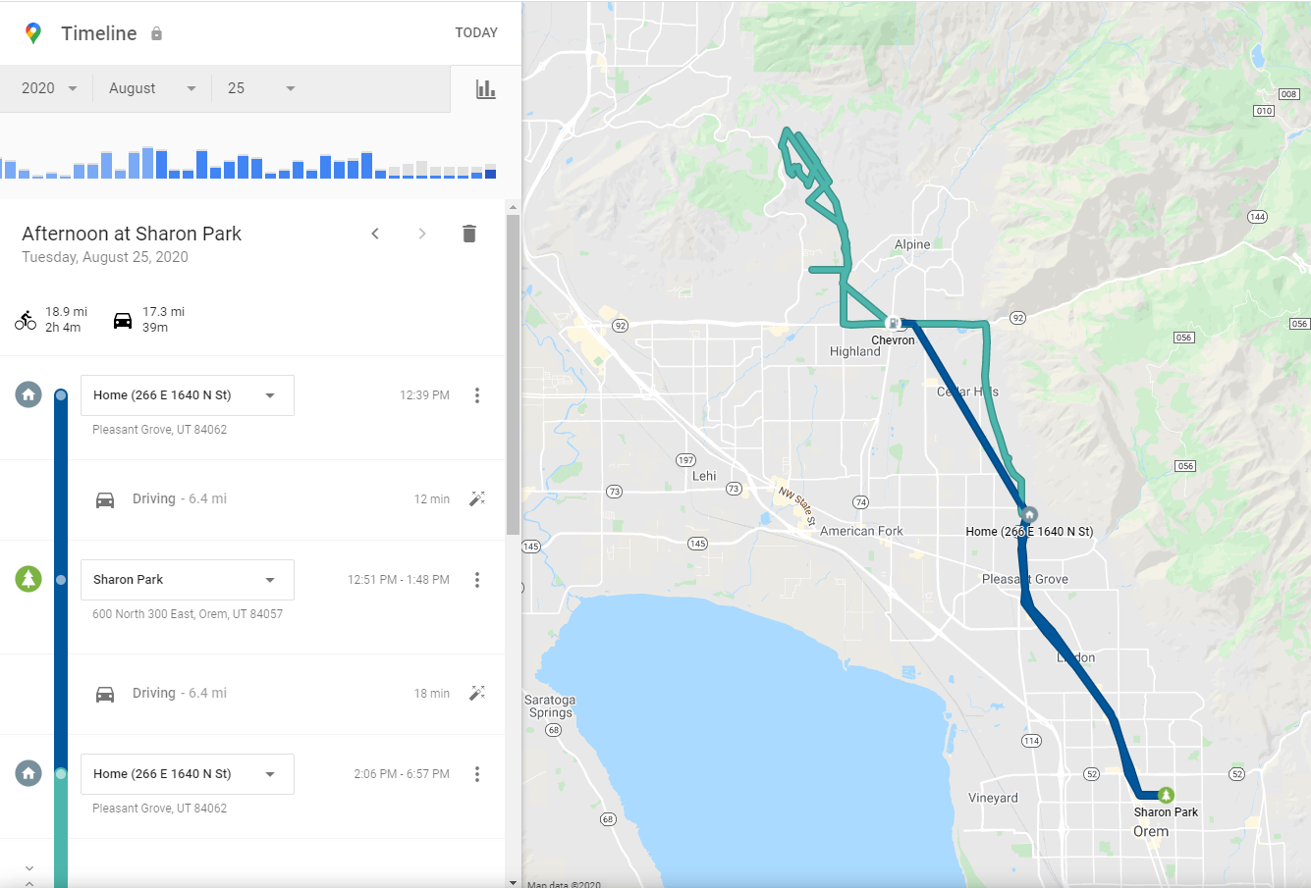
Google maps - Timeline

Slide 31
Make the Data count
Let’s create data

Slide 32
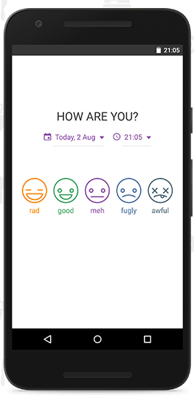
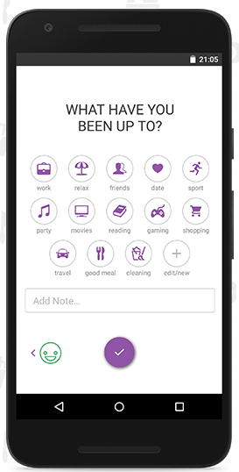
Daylio

Slide 33
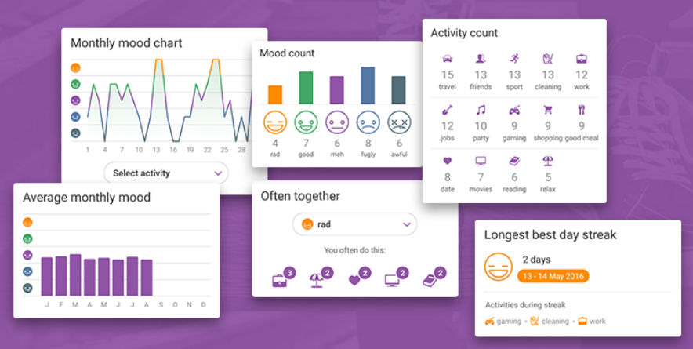
Daylio

Slide 34
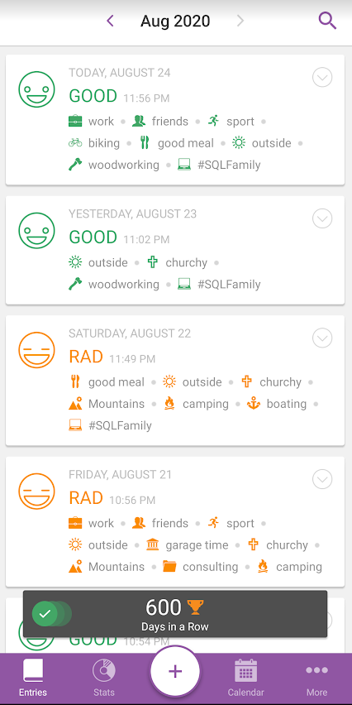
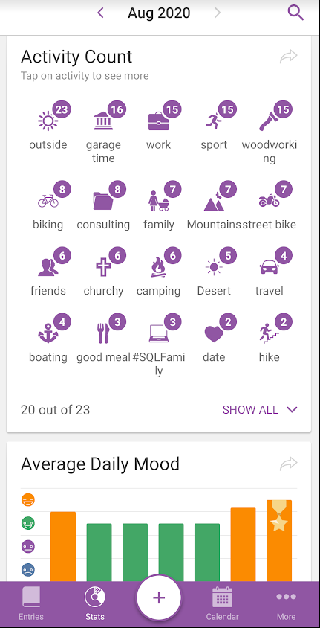
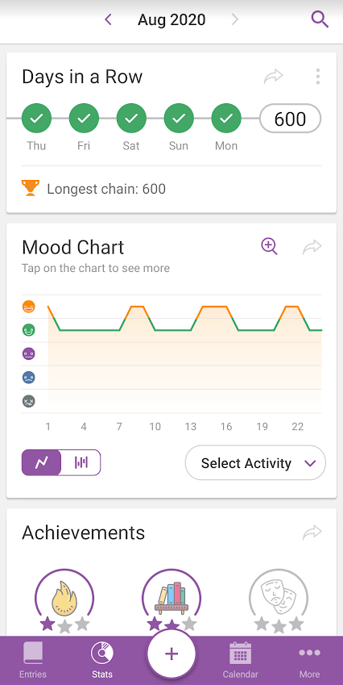
Daylio

Slide 35
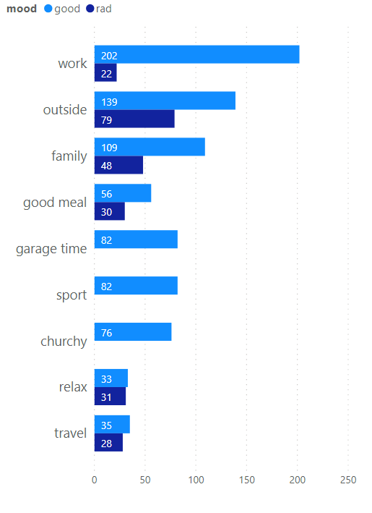
Daylio

Slide 36
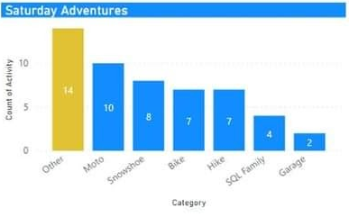
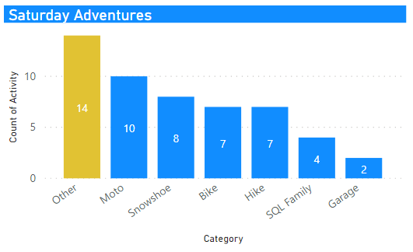
Daylio

Slide 37
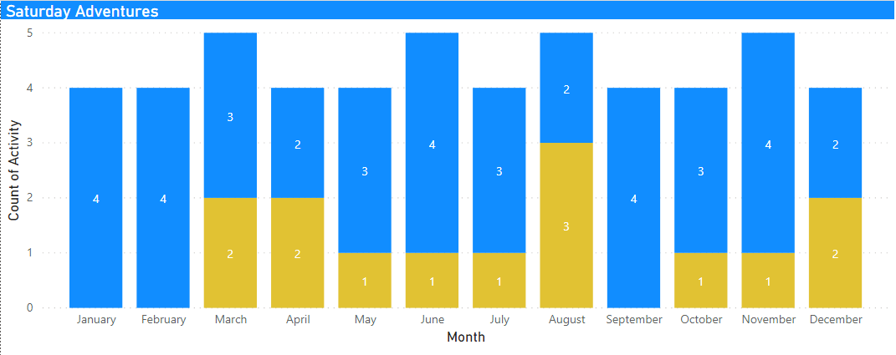
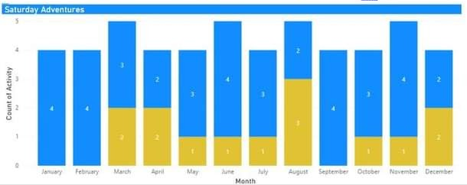
Daylio

Slide 38
Make the Data count
Let’s fill in data

Slide 39
Google Calendar
Looking for gaps in data
Garmin Data Extract
Garmin BaseCamp Data
Daylio Data Extract
Compare to Google Calendar
Compare to Google Photos
Compare to Facebook
Compare to Instagram

Slide 40
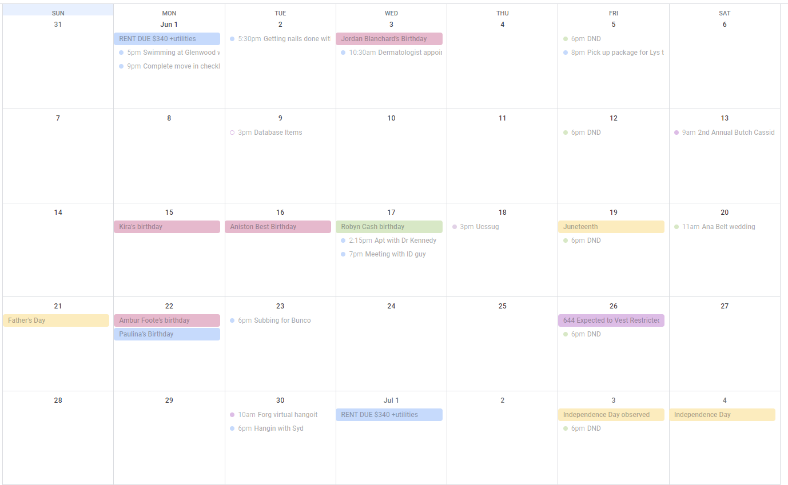
Google Calendar

Slide 41
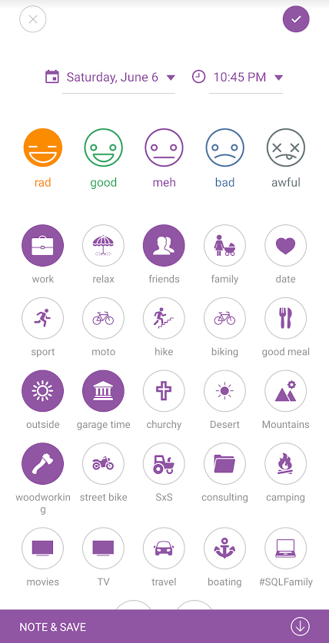
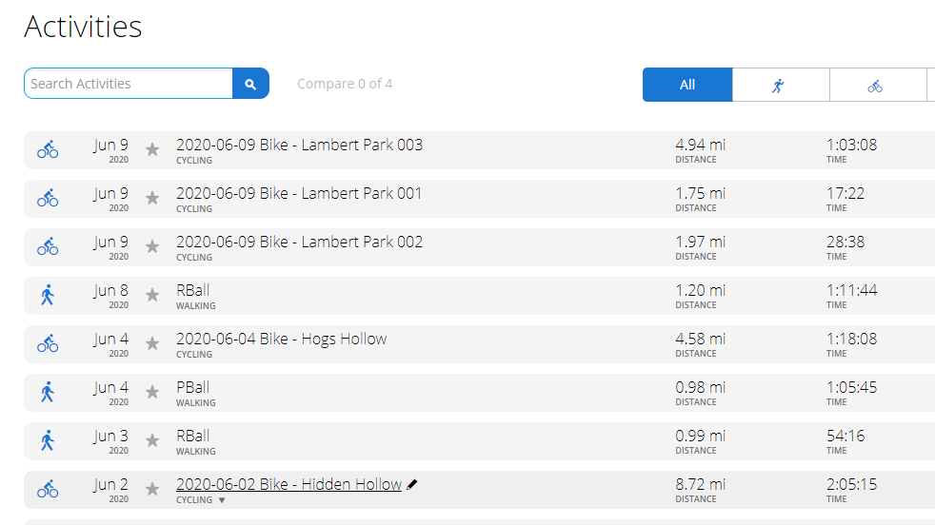
Google Calendar - June 6
What happened on June 6?

Slide 42
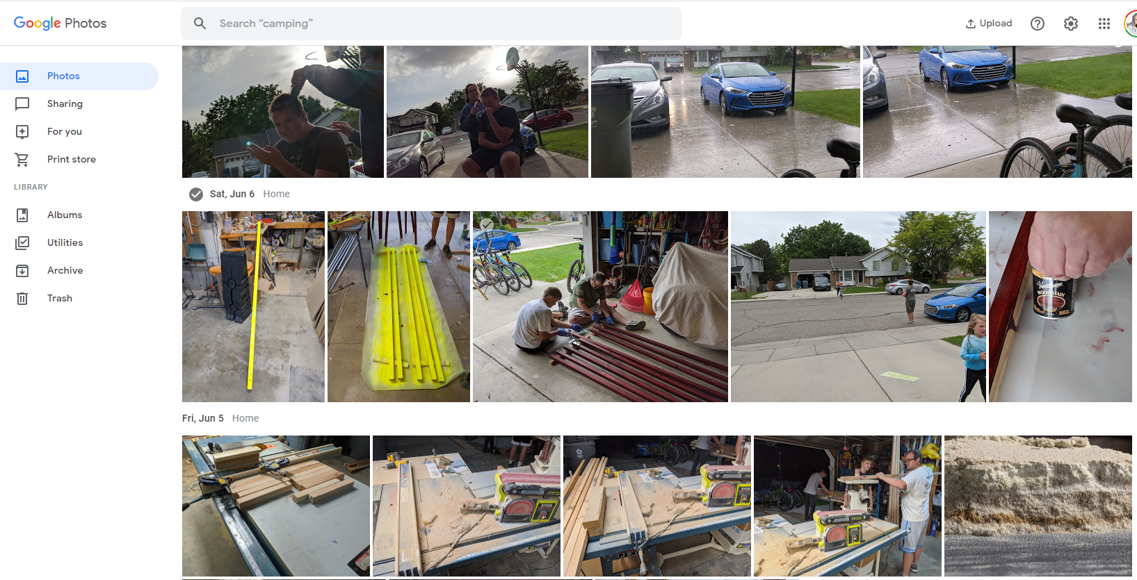
Google Photos – June 6

Slide 43
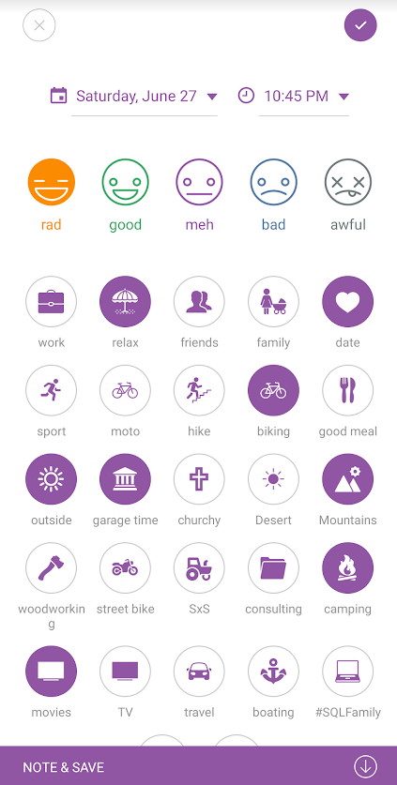
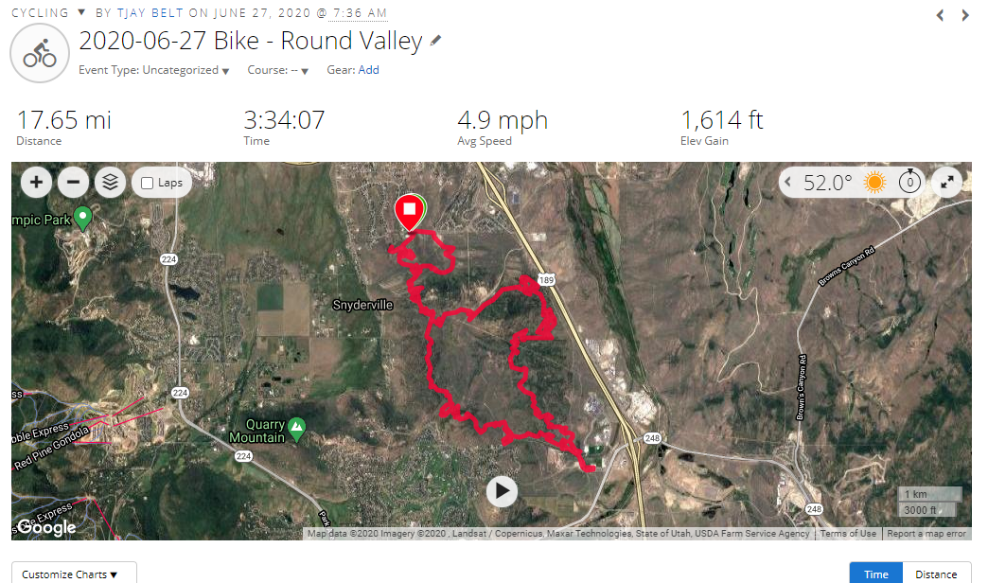
Google Photos – June 27

Slide 44
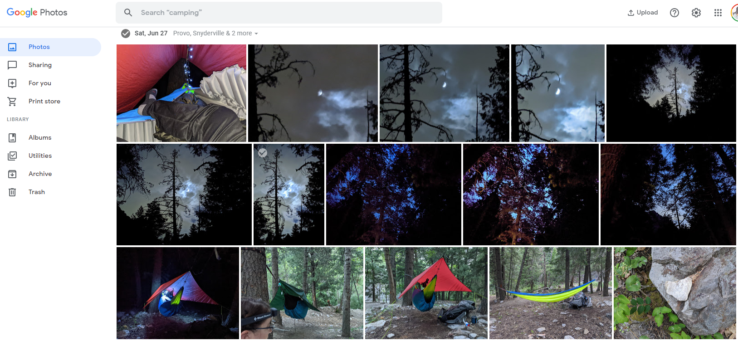
Google Photos – June 27

Slide 45
Facebook / Instagram Photos
Look at posts
Look at history
Piece together activities, if any data exists

Slide 46


Power BI… finally

Slide 47
Power BI
Remember that GPX data?

Slide 48
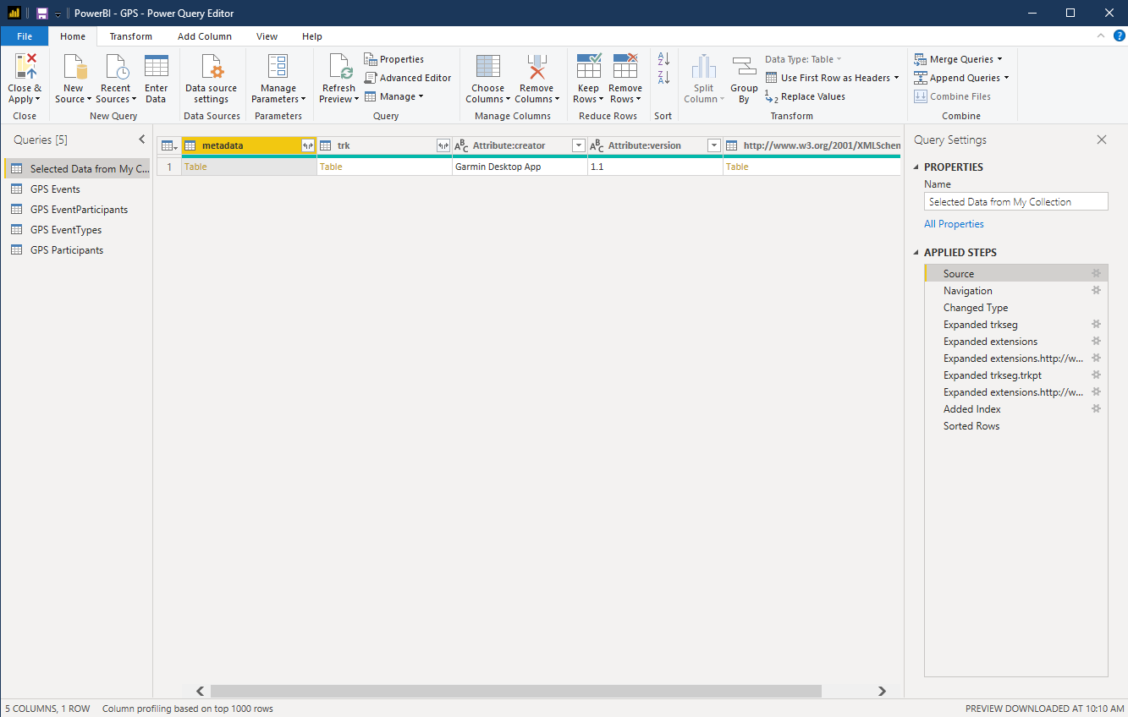
Power BI

Slide 49
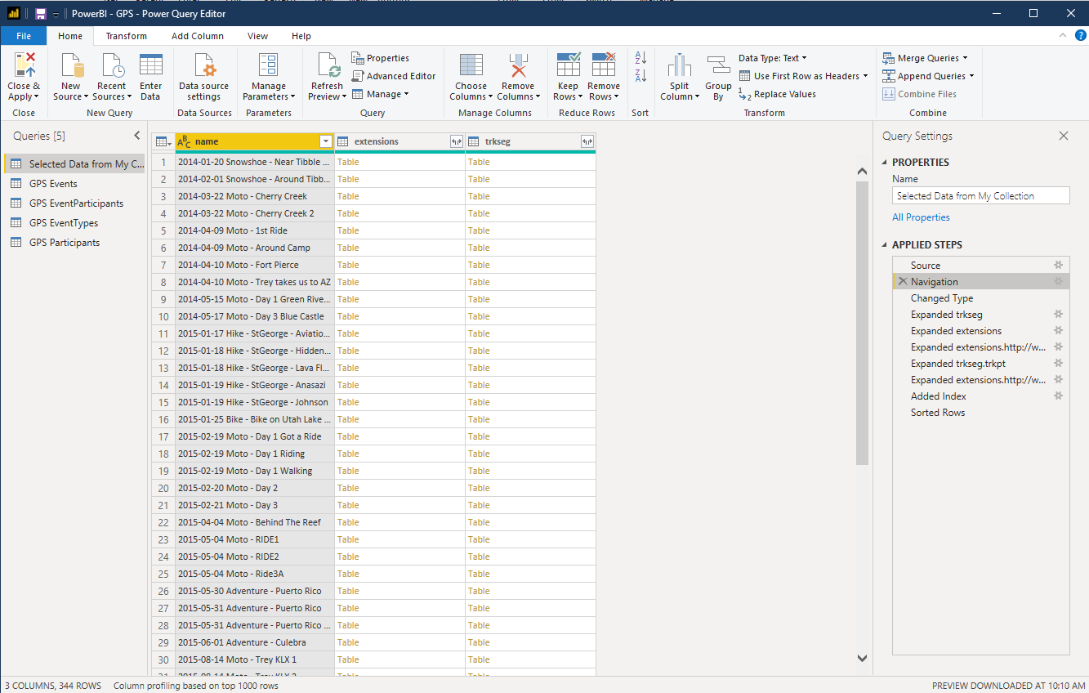
Power BI

Slide 50
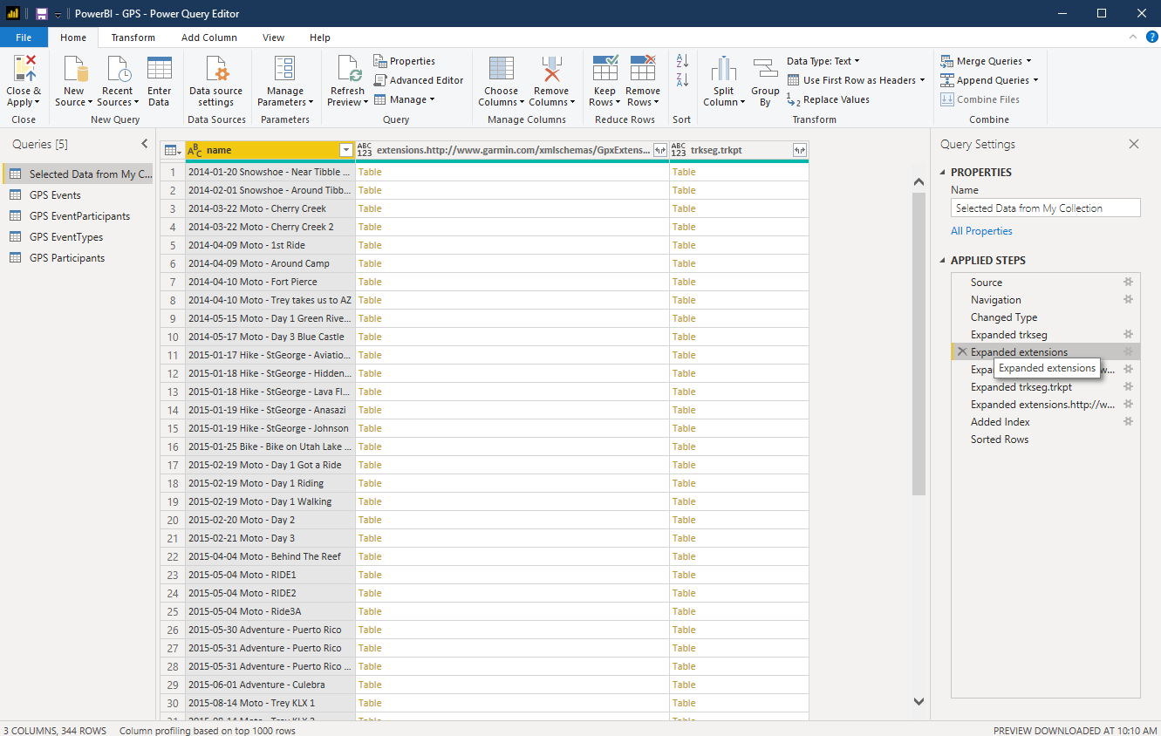
Power BI

Slide 51
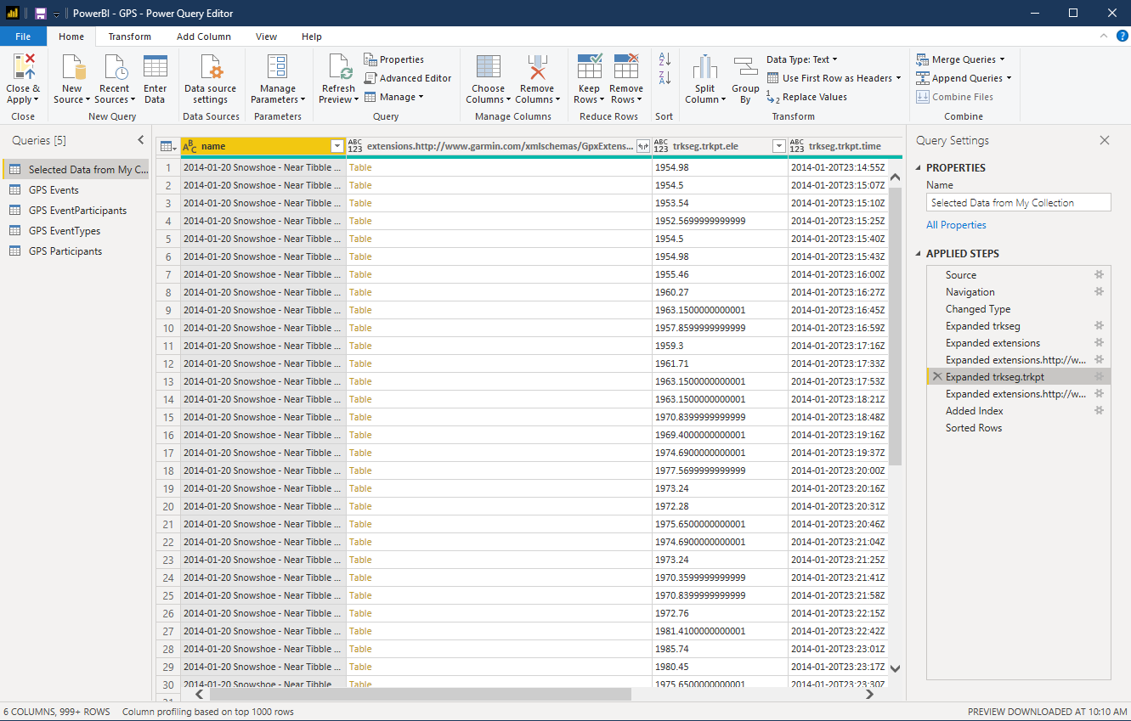
Power BI

Slide 52
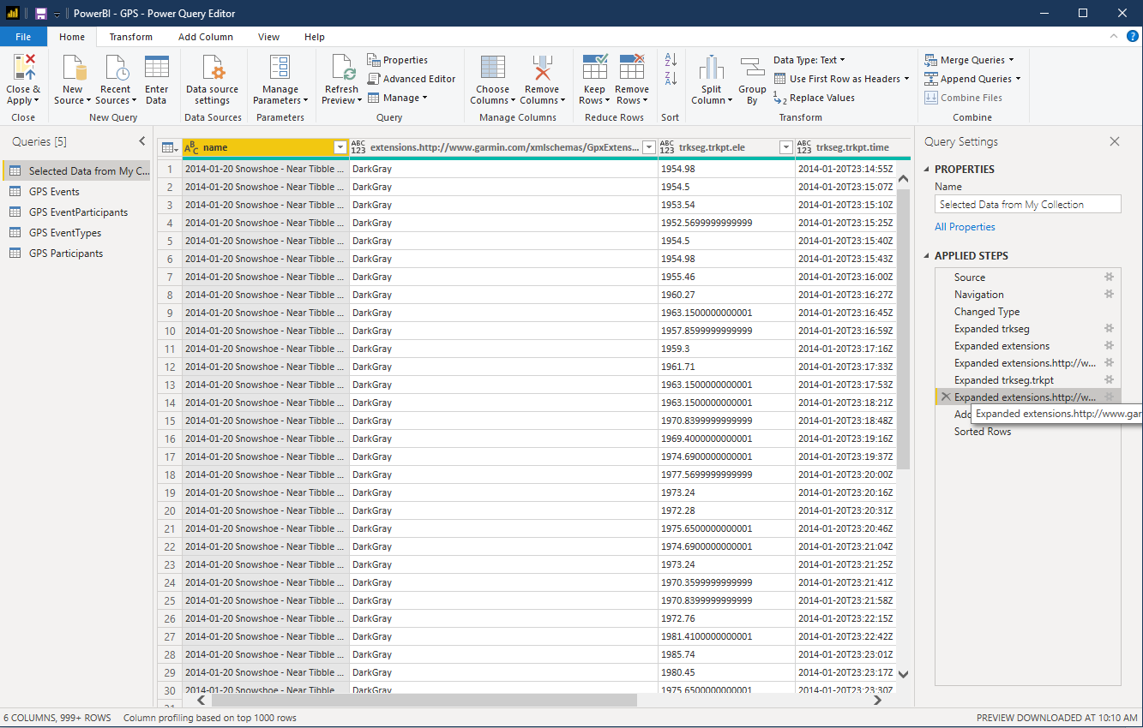
Power BI

Slide 53
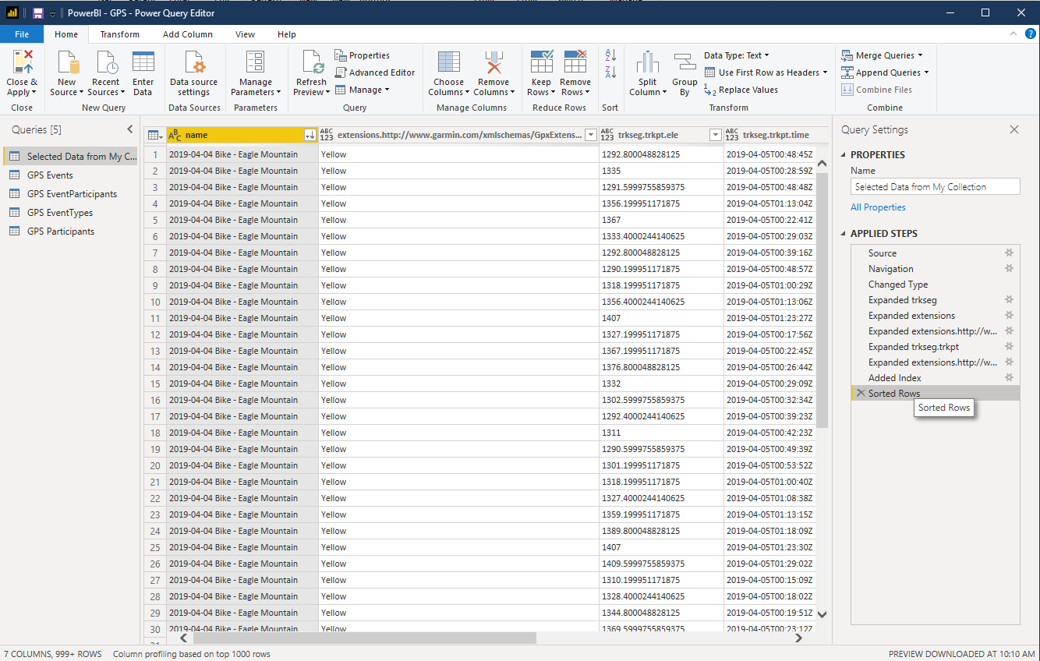
Power BI

Slide 54
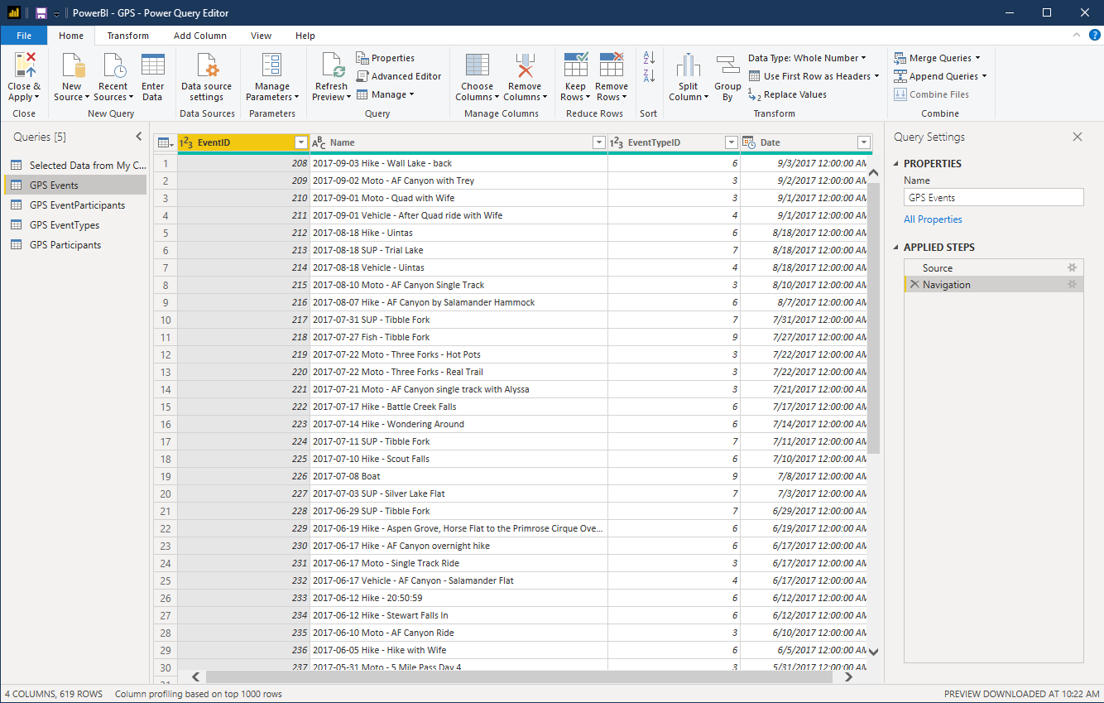
Power BI

Slide 55
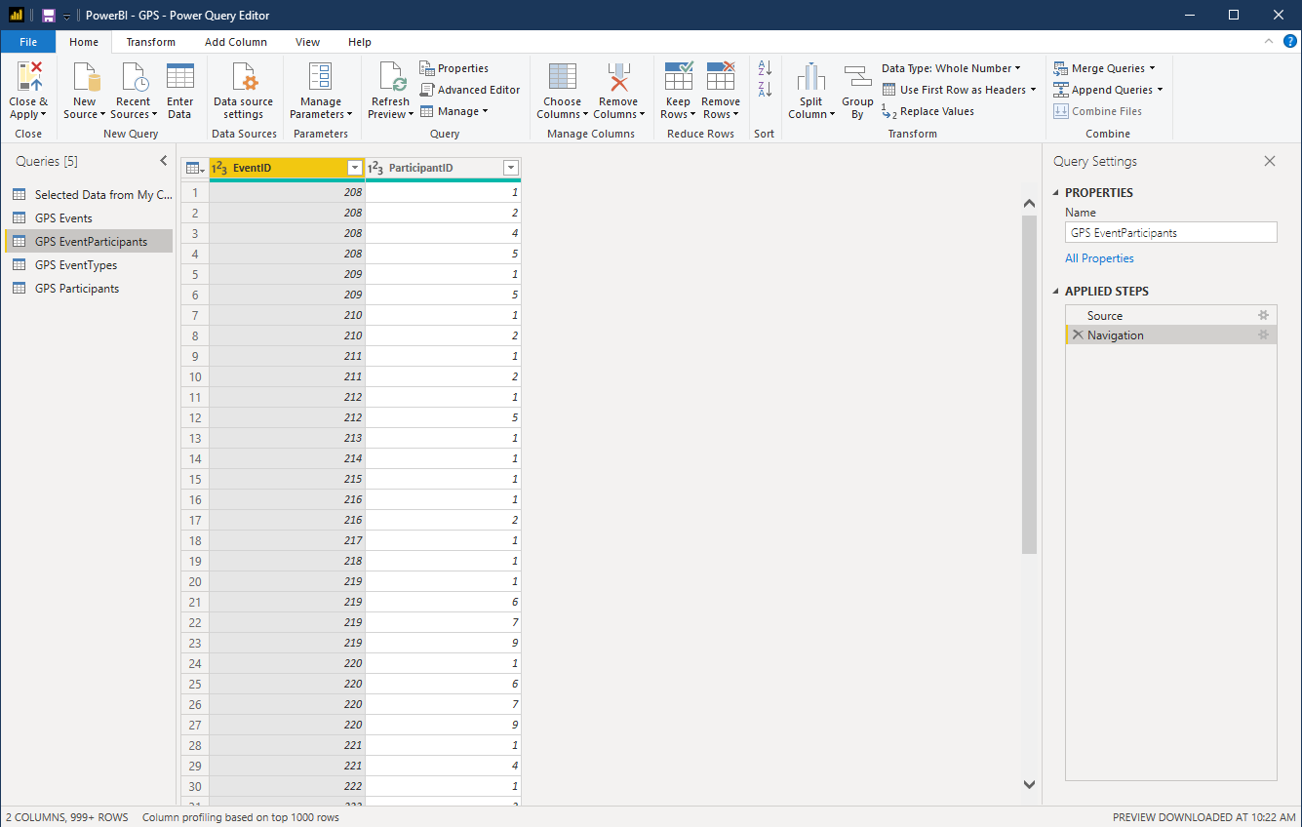
Power BI
Azure Data

Slide 56
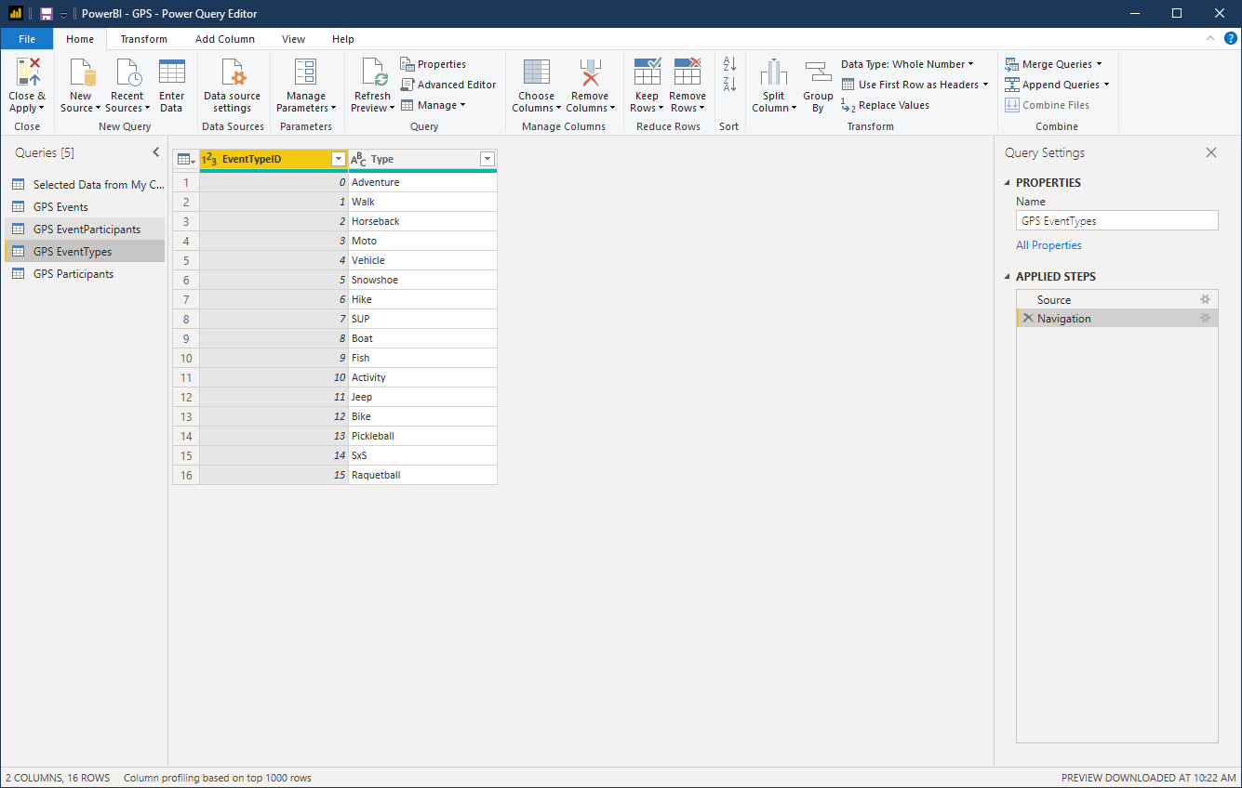
Power BI

Slide 57
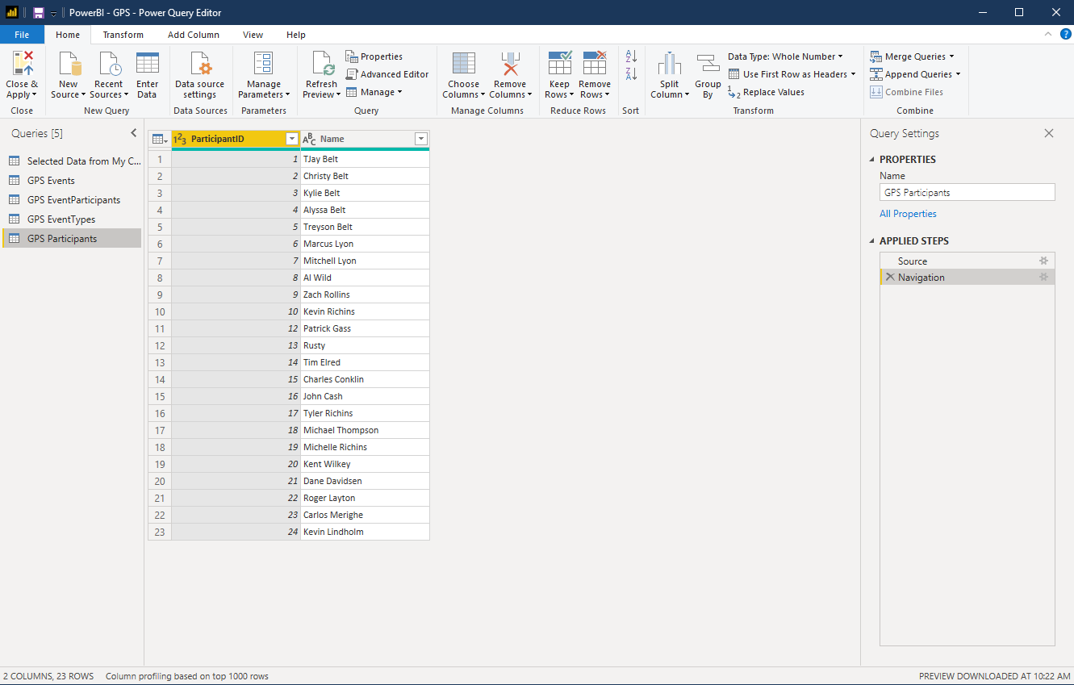
Power BI

Slide 58
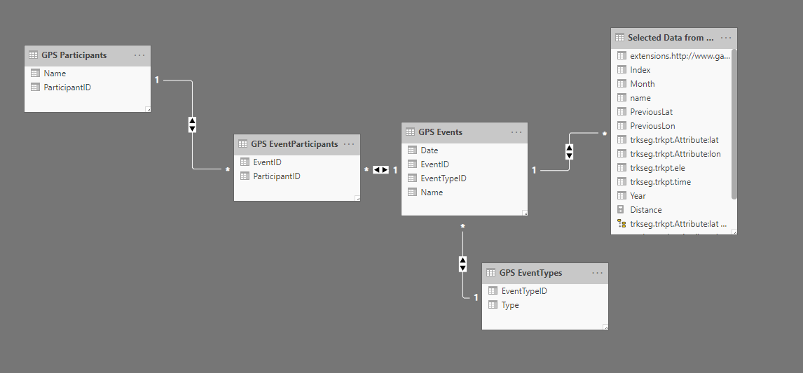
Power BI

Slide 59
Power BI
Adding fields
Month = MID( 'Selected Data from My Collection'[name], 6, 2 )
Year = LEFT( 'Selected Data from My Collection'[name], 4 )

Slide 60
Power BI
Adding fields
Distance
I suck at this one

Slide 61
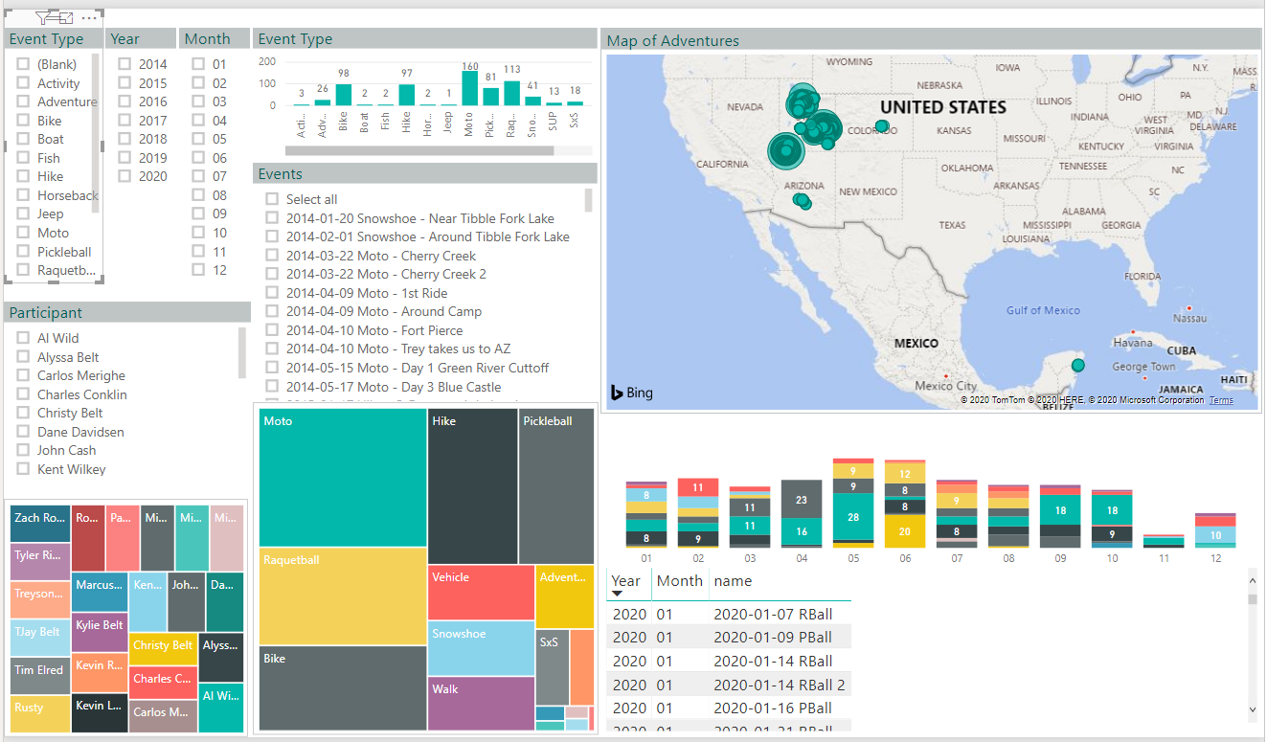
Power BI

Slide 62
Make the Data count
Let’s look at
Power BI

Slide 63
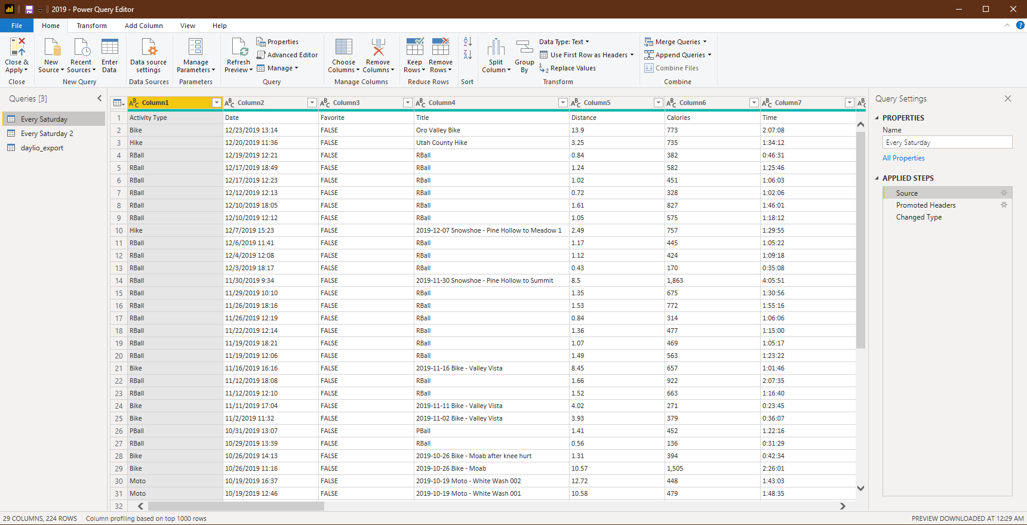
Power BI - Daylio

Slide 64
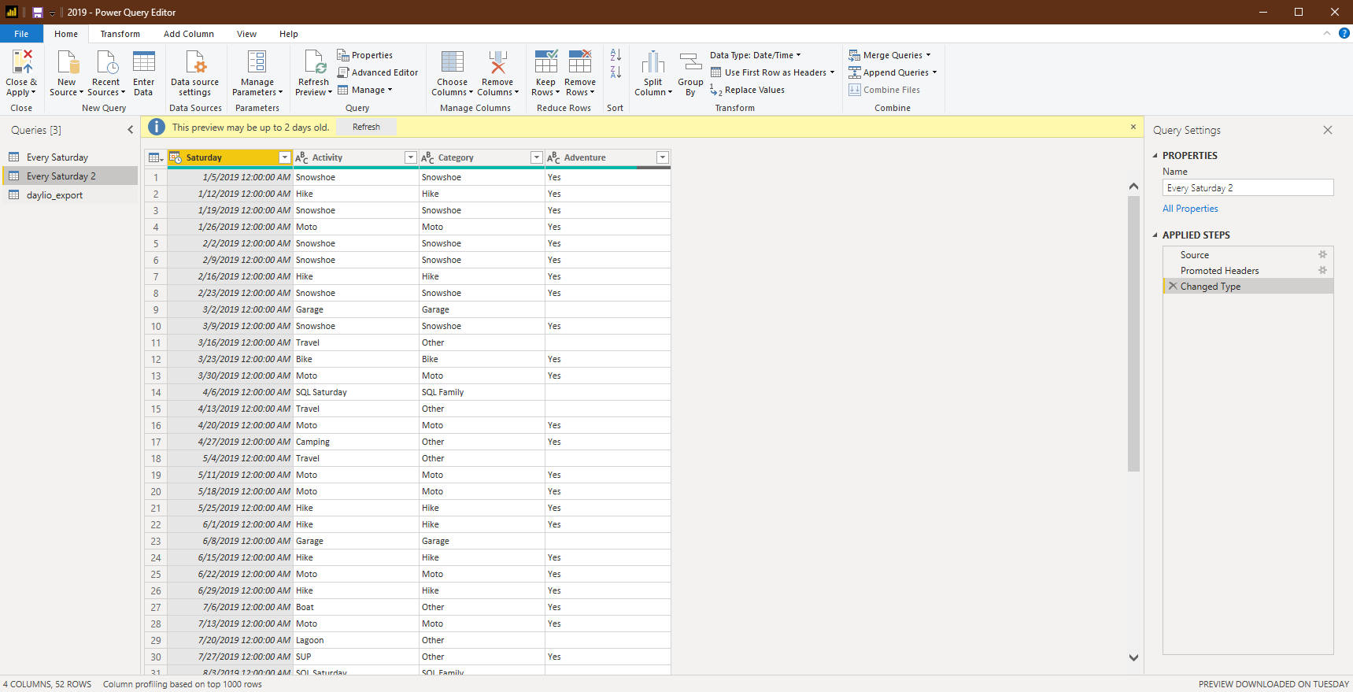
Power BI - Daylio

Slide 65
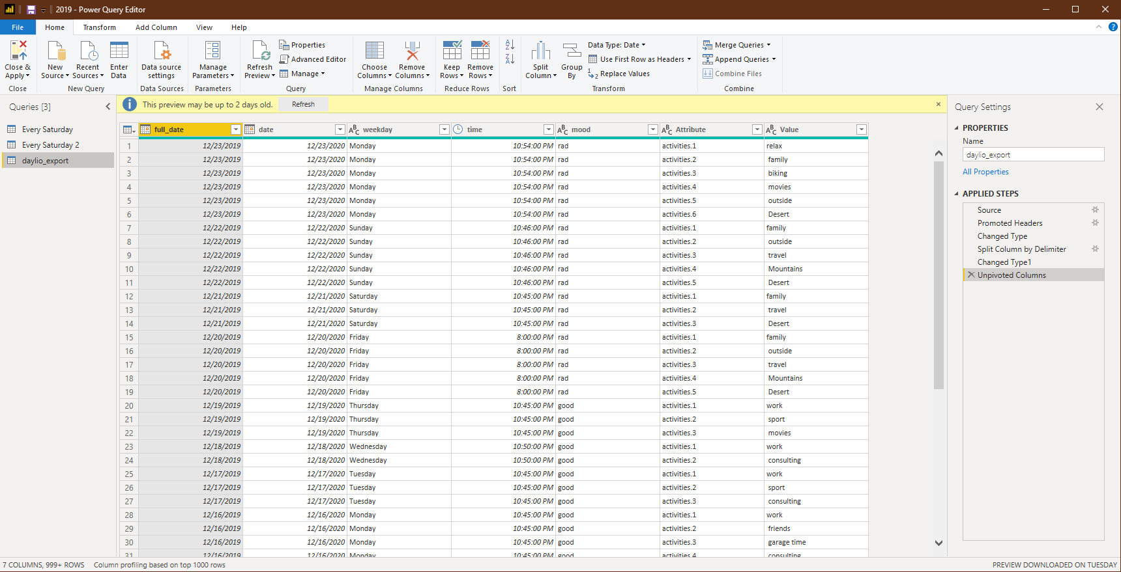
Power BI - Daylio

Slide 66

Power BI - Daylio

Slide 67

Power BI - Daylio

Slide 68

Power BI - Daylio

Slide 69

Power BI - Daylio

Slide 70
Make the Data count
Let’s look at
Power BI

Slide 71


Slide 72


Slide 73


Slide 74


Slide 75


Slide 76


Slide 77
Session Evaluations
https://www.sqlsaturday.com/997/Sessions/Session-Evaluation
Alternatively go to the Schedule and click on the session you would like to give feedback on and click Session Evaluation

